Slide 1
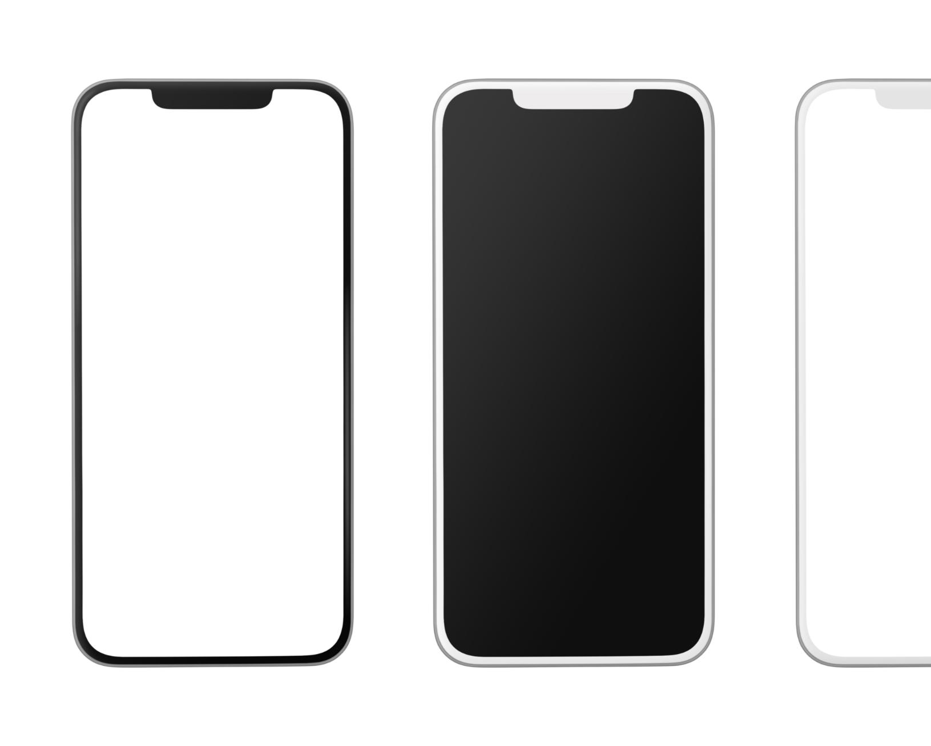
The Evolution of Smartphones: From Early Beginnings to Modern Innovations
A journey through mobile technology advancements
Notes:
AI-generated content may be incorrect. --- Smartphones have radically transformed the way we communicate, work, and live. This presentation will explore the journey of mobile technology from its early days to today's cutting-edge innovations.

Slide 2
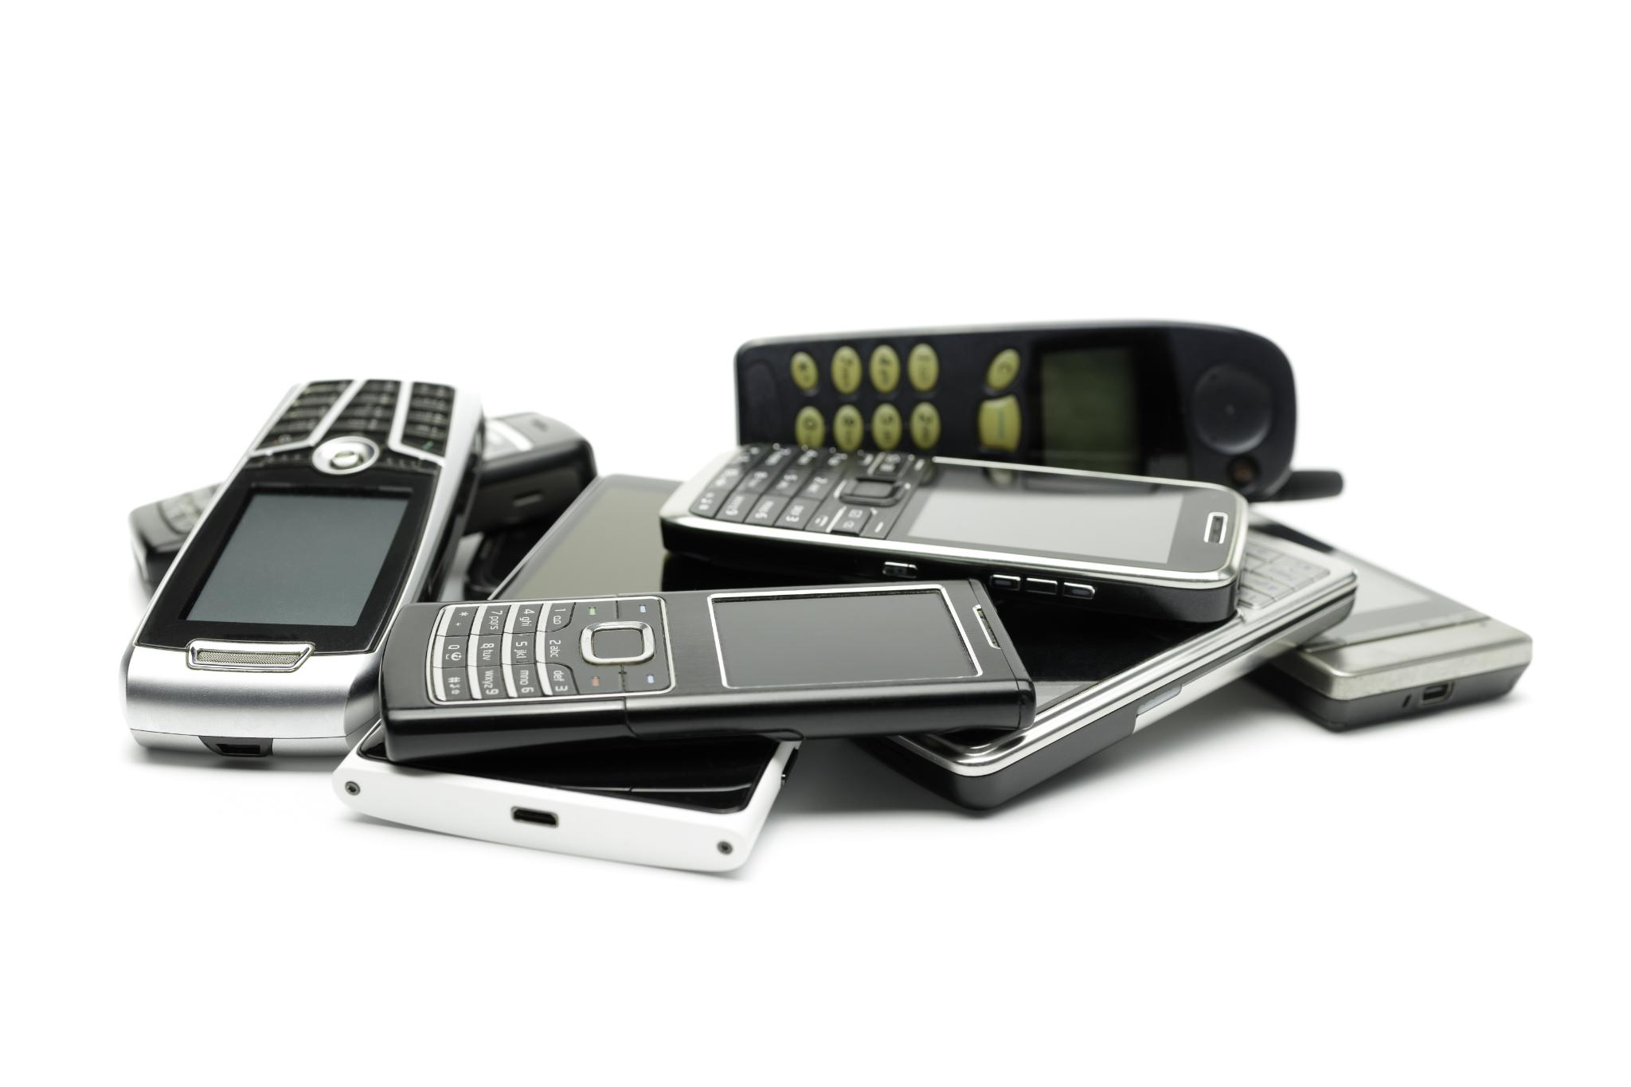
Agenda Items
The Early Days of Mobile Communication
Transition to Smart Devices
Evolution of Phone Displays
Impact on Society and Daily Life
Future Trends and Innovations
Notes:
In this presentation, we will begin with the early days of mobile communication, discussing the introduction of mobile phones and the evolution of cellular networks. Next, we will explore the transition to smart devices and advancements in display technology. We will also examine the impact of smartphones on society and conclude with future trends and innovations in mobile technology.

Slide 3
The Early Days of Mobile Communication
Notes:
The origins of mobile communication laid the groundwork for the smartphones we use today. Early mobile phones were groundbreaking inventions that changed personal and business communication.

Slide 4
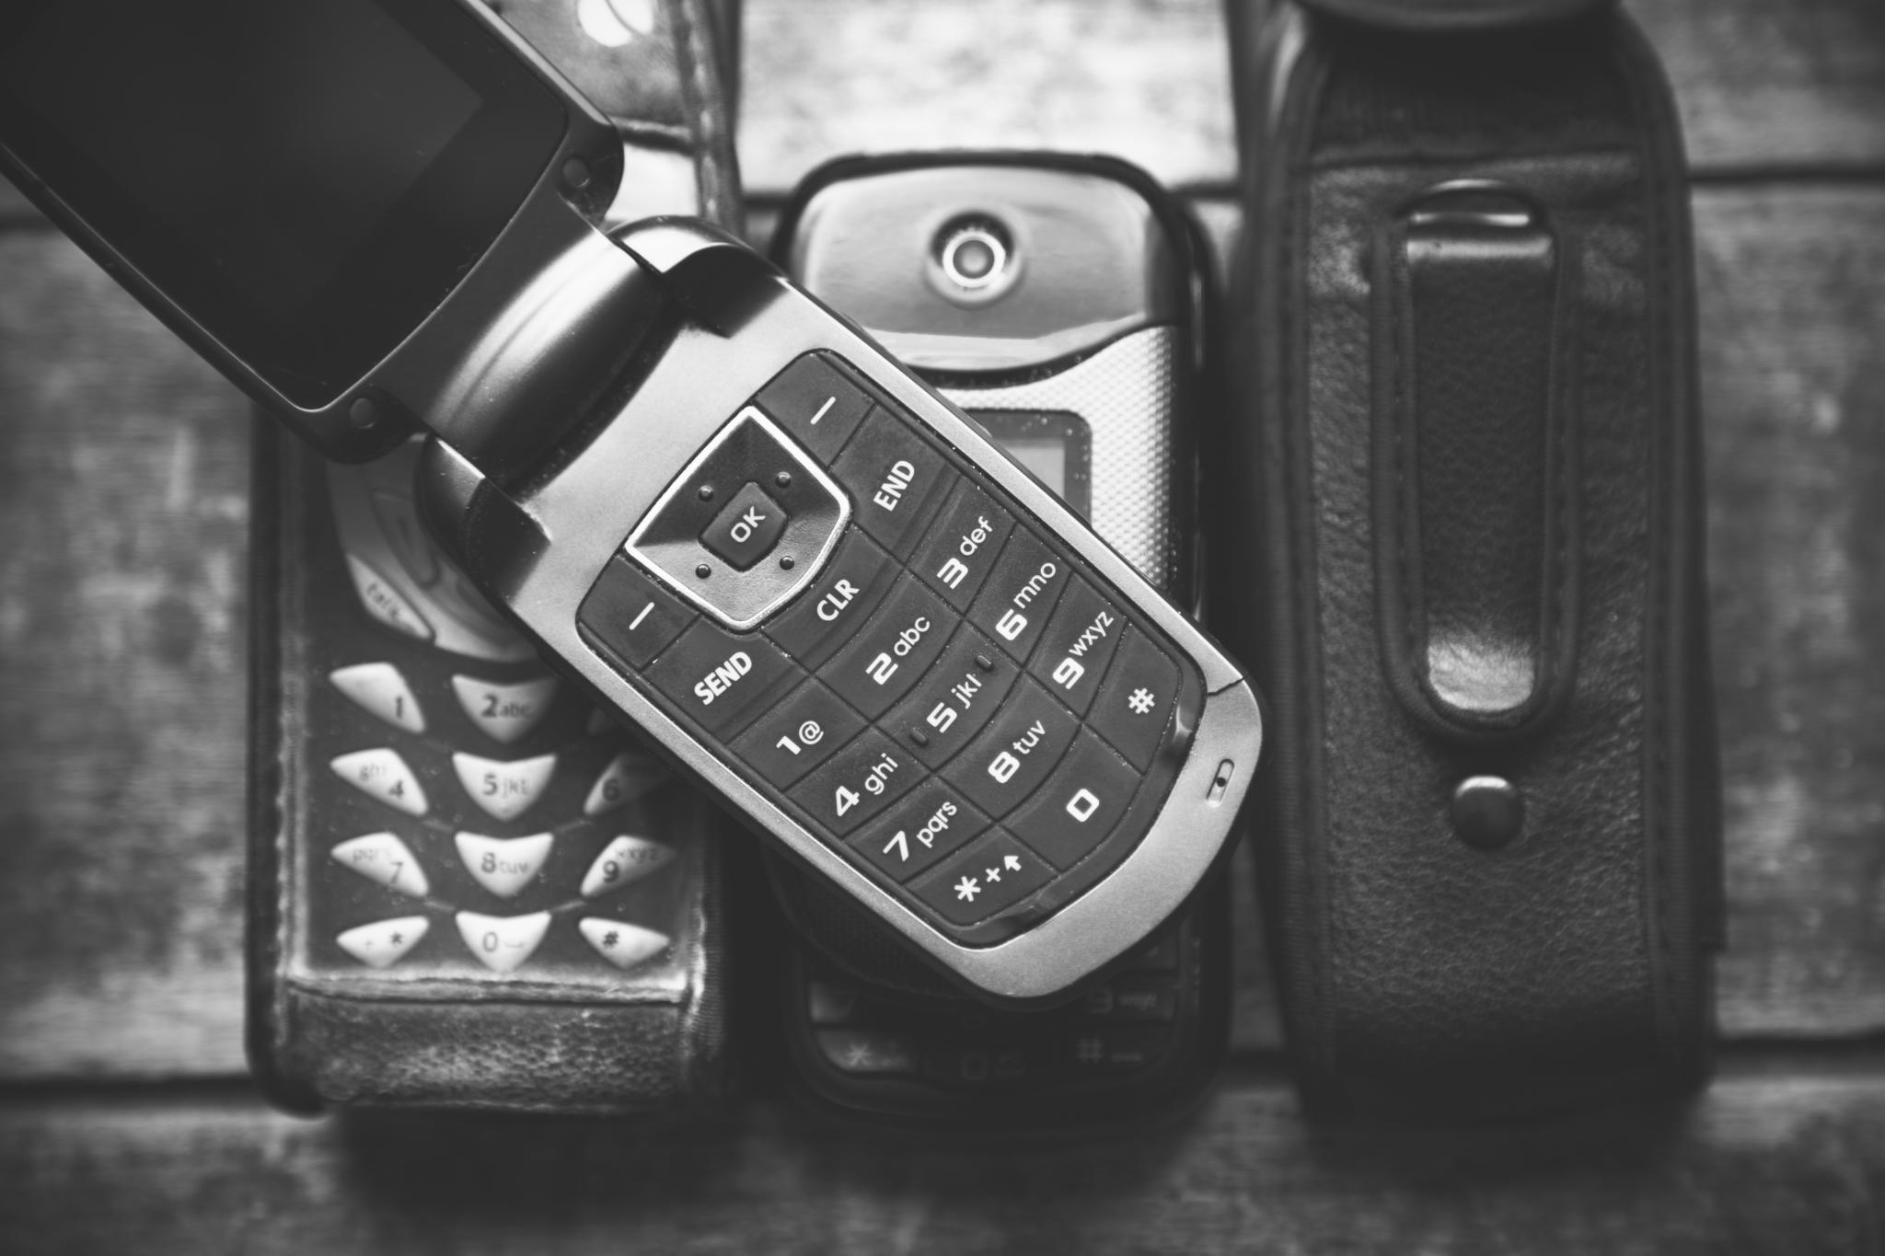
Introduction of Mobile Phones
Early Mobile Phones
The first mobile phones were large and heavy, designed mainly for voice communication, marking the start of mobile revolution.
Revolution in Communication
The introduction of mobile phones transformed communication, allowing users to make calls from virtually anywhere.
Notes:
The first mobile phones were large, cumbersome devices primarily used for voice calls. Introduced in the 1980s, they revolutionized communication by enabling users to make calls from anywhere.

Slide 5
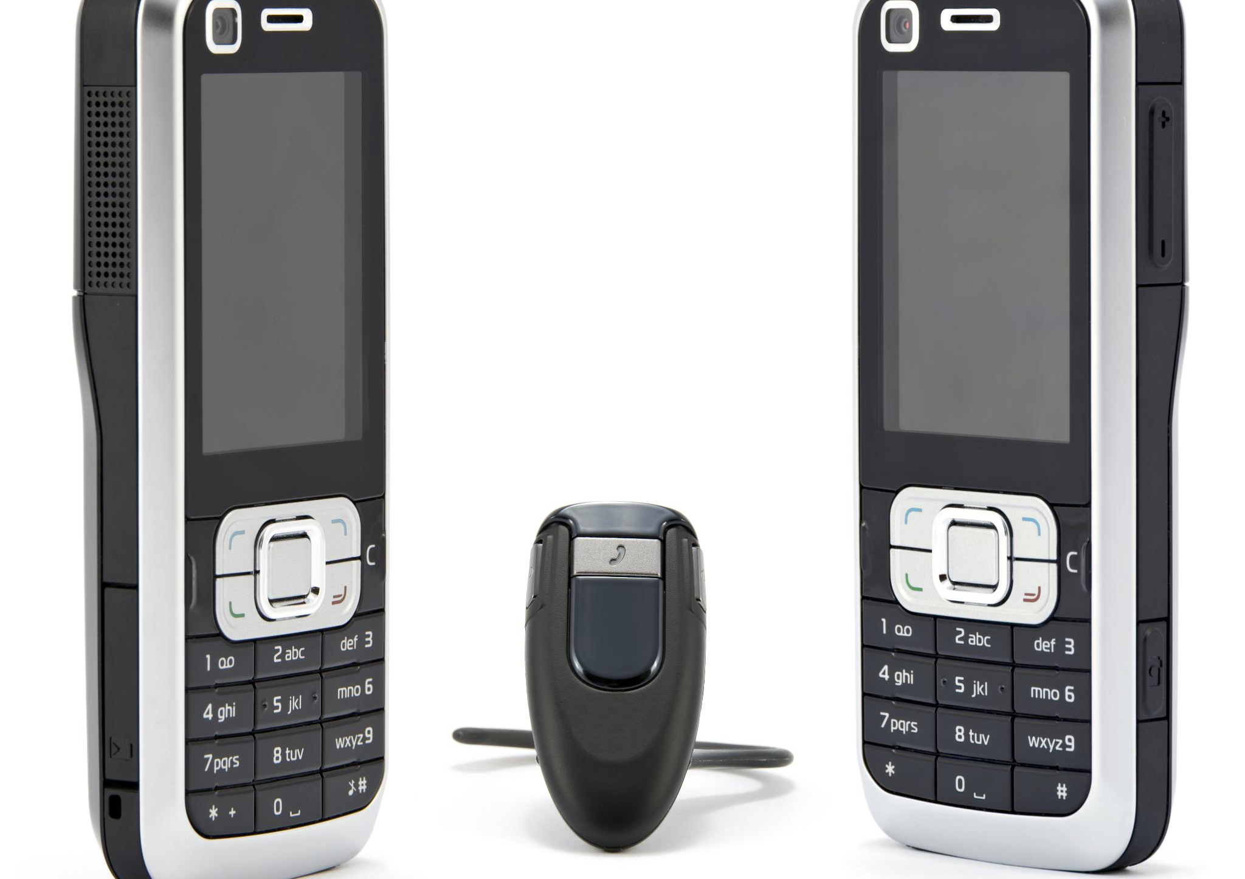
First Generation (1G) Cellular Networks
Introduction to 1G Technology
1G networks marked the beginning of cellular technology, enabling mobile communication through analog signals.
Voice Transmission Quality
The voice transmission quality in 1G networks was relatively low, with significant static and interference.
Capacity and Coverage Limitations
1G networks had limited capacity and coverage, restricting the number of simultaneous calls.
Notes:
1G networks were the first generation of cellular technology, providing analog communication. These networks offered low-quality voice transmission and were limited in terms of capacity and coverage.

Slide 6
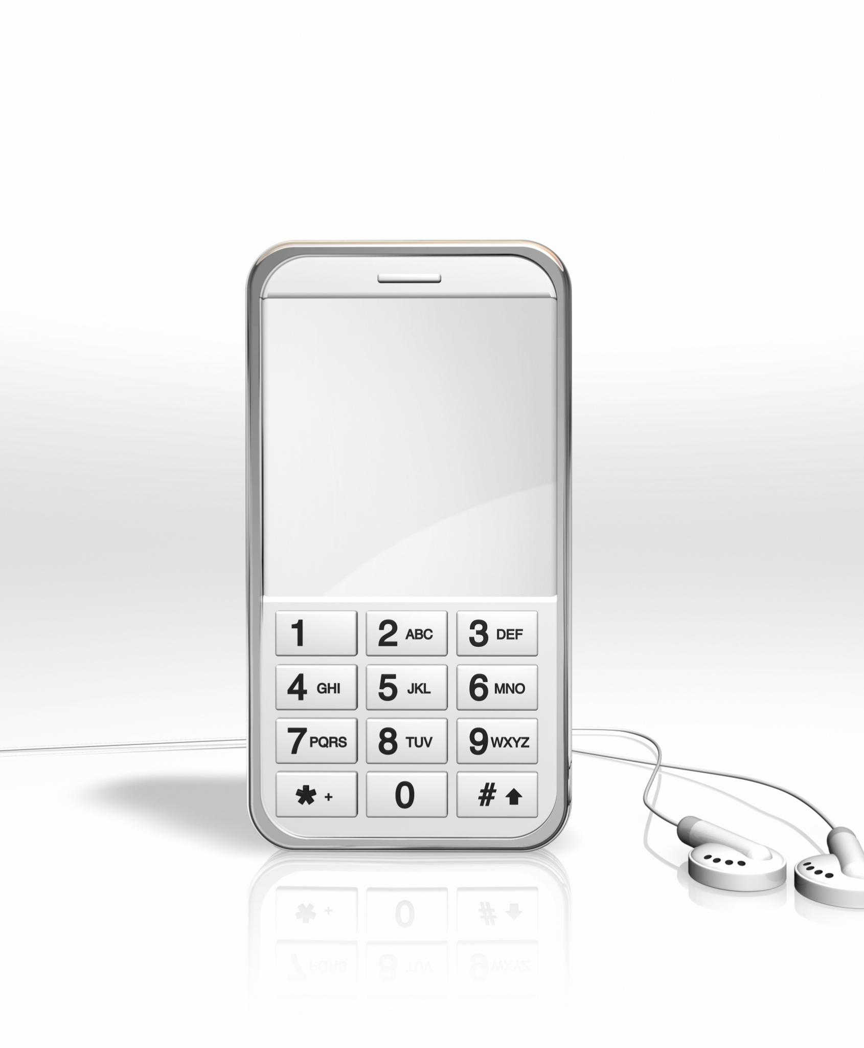
The Legacy of Sony Ericsson
Sony Ericsson was a joint venture founded in 2001 between Sony and Ericsson.
The brand was known for its innovative mobile phones and music integration.
Sony Ericsson popularized the Walkman and Cyber-shot phone lines.
Notes:
Sony Ericsson was a notable brand in the mobile phone industry, combining Sony's expertise in consumer electronics with Ericsson's telecommunications knowledge. The brand became famous for its stylish designs and features like music playback through the Walkman series and high-quality photography with the Cyber-shot line. These innovations contributed to the evolution of mobile technology and user experience.

Slide 7
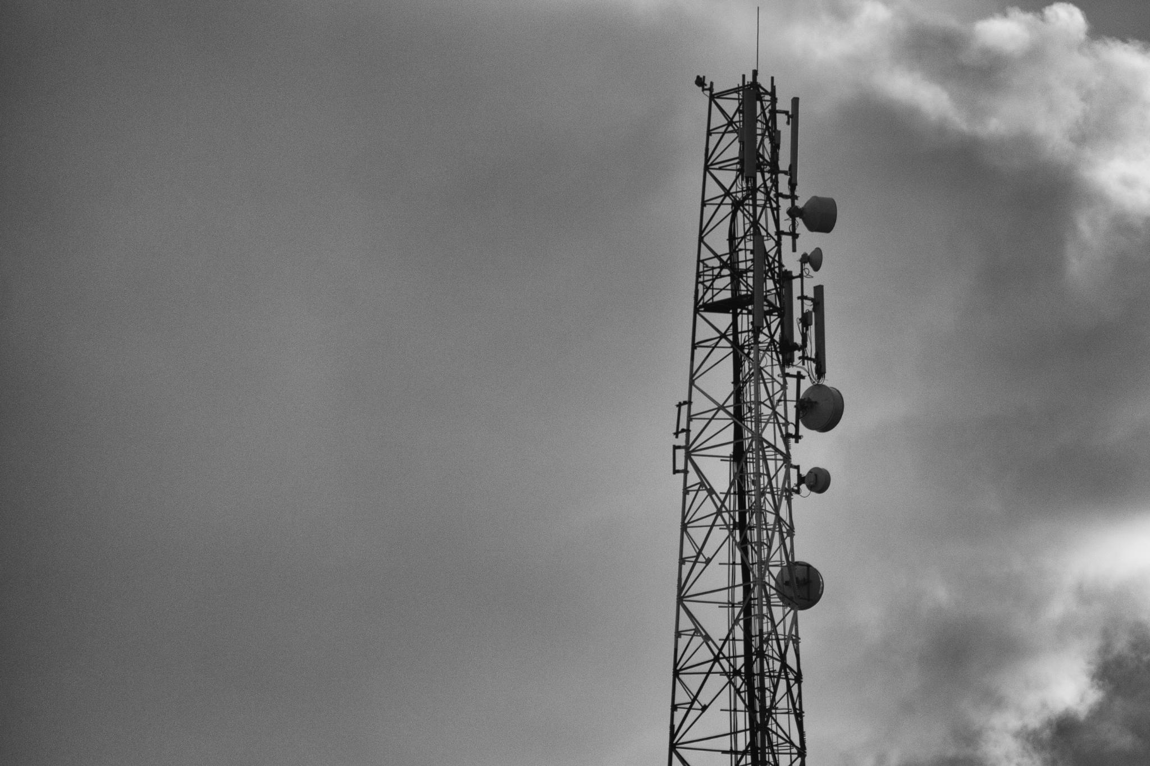
Key Milestones and Early Devices
Motorola DynaTAC Launch
The Motorola DynaTAC was the first commercially available mobile phone, marking a revolutionary step in mobile communication.
First Cellular Networks
The establishment of the first cellular networks was a significant milestone that enabled mobile communication on a large scale.
Advancements in Mobile Technology
These milestones laid the groundwork for the rapid advancements in mobile technology that followed in the coming decades.
Notes:
Early milestones include the launch of the Motorola DynaTAC, the first commercially available mobile phone, and the establishment of the first cellular networks, marking significant advancements in mobile technology.

Slide 8
Transition to Smart Devices
Notes:
As technology advanced, the transition to smart devices began, paving the way for the multifunctional smartphones we rely on today. This period was marked by significant developments in network technology and device capabilities.

Slide 9
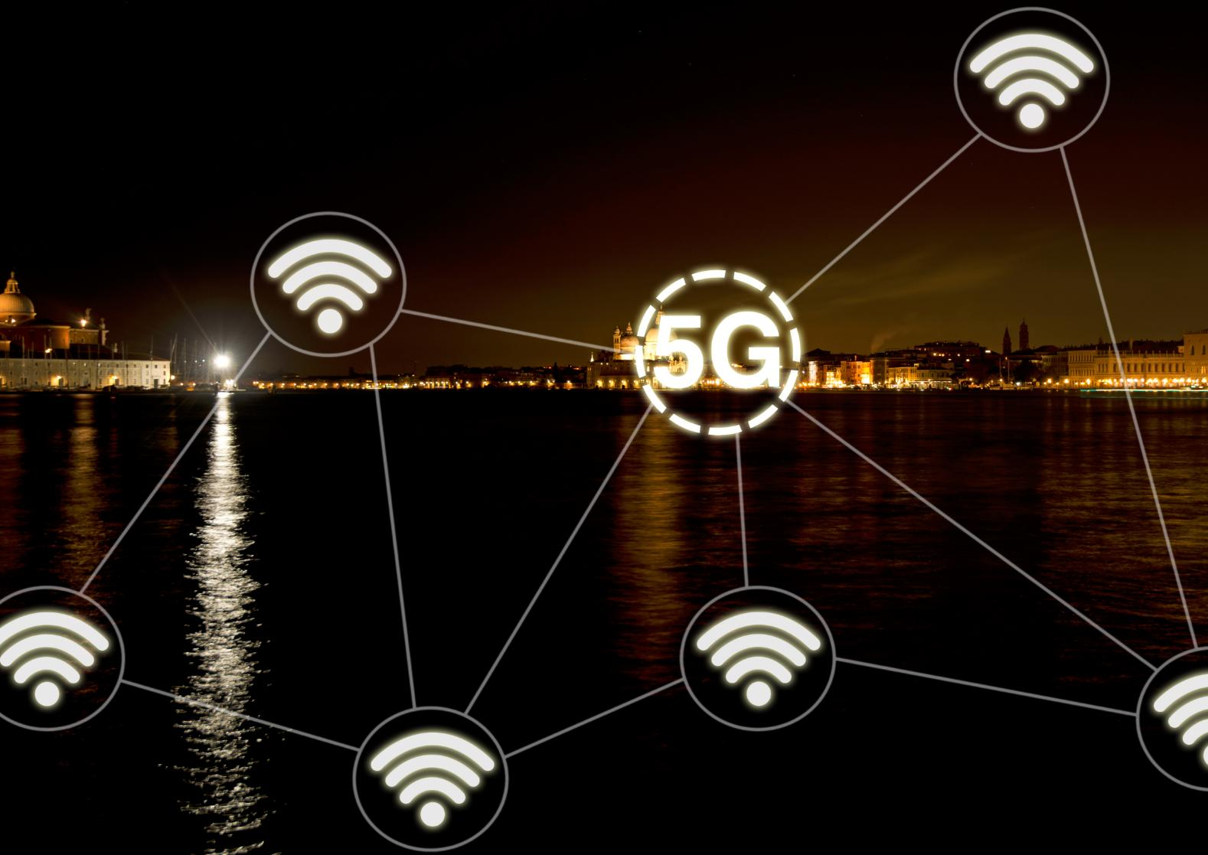
Development of 2G and 3G Networks
2G Networks Introduction
The launch of 2G networks marked the shift to digital communication, enhancing call quality and enabling text messaging.
Advancements in 3G
3G networks revolutionized mobile internet access, providing faster data transmission and enabling better online experiences.
Notes:
The introduction of 2G networks brought digital communication, enabling text messaging and improved call quality. 3G networks further advanced mobile internet access, allowing for faster data transmission.

Slide 10
Introduction of PDAs and Early Smart Devices
Emergence of PDAs
Personal Digital Assistants were among the first smart devices, providing essential features for personal organization.
Key Features of PDAs
PDAs offered functionalities like calendars, task management, and contact storage, enhancing personal productivity.
Foundation for Smartphones
The capabilities of PDAs paved the way for modern smartphones, influencing their features and functionalities.
Notes:
Personal Digital Assistants (PDAs) emerged as early smart devices, offering features like calendars and contact management. These devices set the stage for the development of smartphones as we know them today.

Slide 11
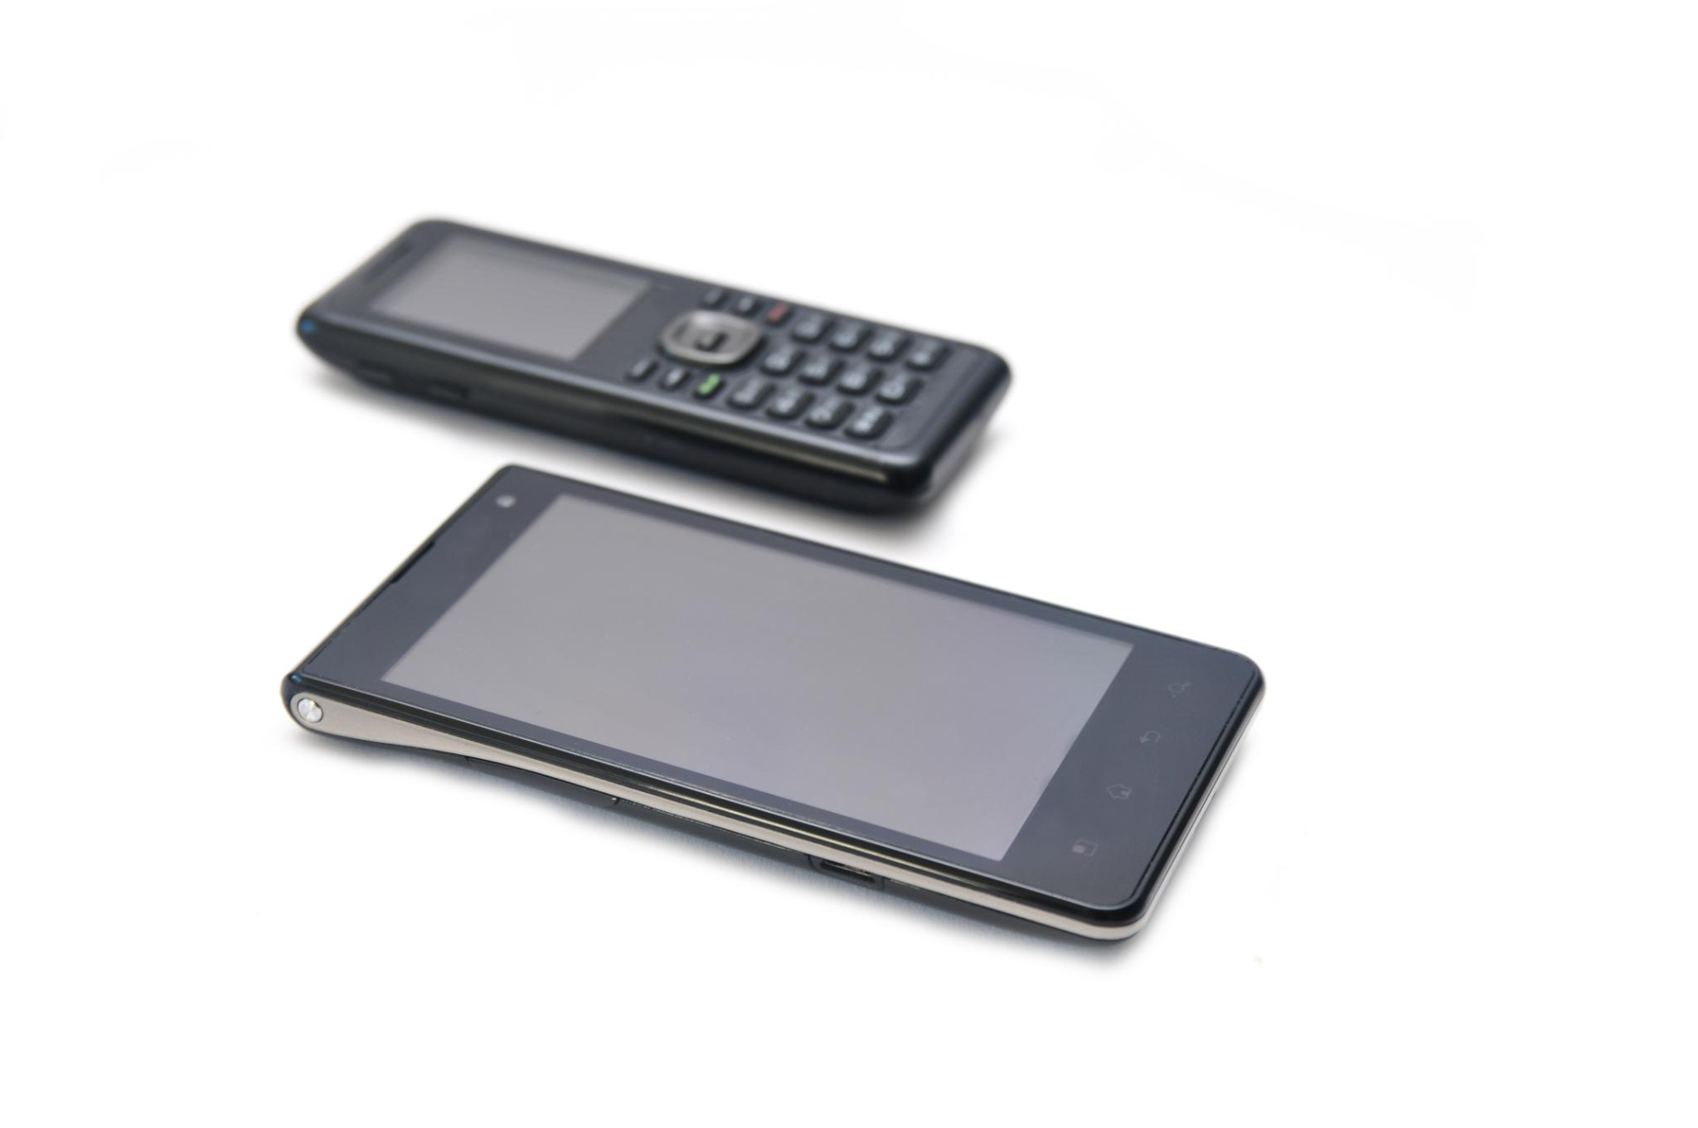
Key Players and Pioneering Models
Palm's Innovation
Palm was a key player in the smartphone market, introducing innovative devices that combined handheld computing with mobile communication.
BlackBerry's Market Influence
BlackBerry's smartphones were renowned for their security features and email capabilities, making them a favorite among professionals.
Nokia's Pioneering Models
Nokia played a crucial role in the smartphone evolution with devices that offered durability and user-friendly interfaces.
Notes:
Key players in the smartphone market included companies like Palm, BlackBerry, and Nokia, which introduced pioneering models that shaped the industry's direction and consumer expectations.

Slide 12
Evolution of Phone Displays
Notes:
Display technology has evolved significantly, enhancing user experience and functionality. From early monochrome screens to modern high-resolution displays, this evolution has played a crucial role in smartphone development.

Slide 13
Early Monochrome and LCD Displays
Monochrome Displays
Early mobile phones used monochrome displays, which limited visual interaction and user experience.
Introduction of LCD Technology
The shift to LCD technology represented a major advancement, improving readability and usability of mobile devices.
User-Friendly Interface
LCD displays enhanced the user interface, making mobile devices more intuitive and accessible for users.
Notes:
Initial mobile phones featured monochrome displays, which limited visual interaction. The introduction of LCD technology allowed for improved readability and a more user-friendly interface.

Slide 14
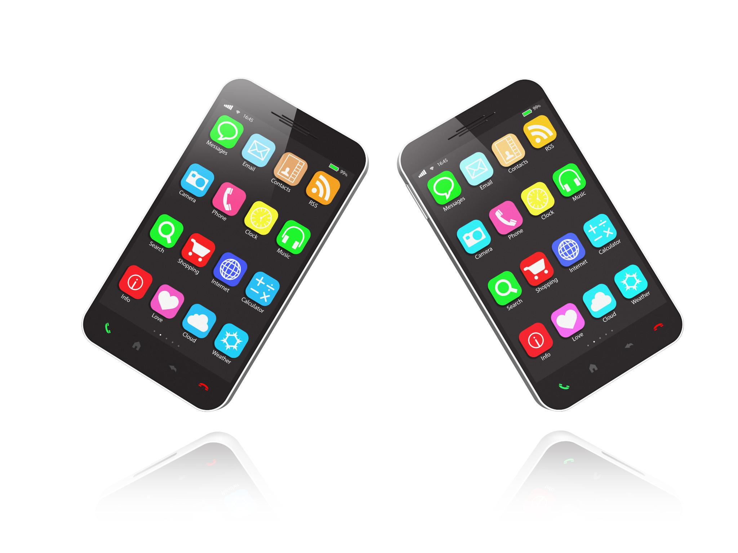
Introduction of Color Screens and Touch Technology
Revolution of Color Screens
The introduction of color screens transformed user interactions, enhancing visual experiences across all digital devices.
Elimination of Physical Buttons
Touch technology eliminated the need for physical buttons, allowing for more seamless and intuitive user interfaces.
Rise of Touchscreen Smartphones
The combination of color screens and touch technology led to the rapid rise of touchscreen smartphones, changing communication and accessibility.
Notes:
The advent of color screens revolutionized how users interacted with their devices, while touch technology eliminated the need for physical buttons, leading to the rise of touchscreen smartphones.

Slide 15
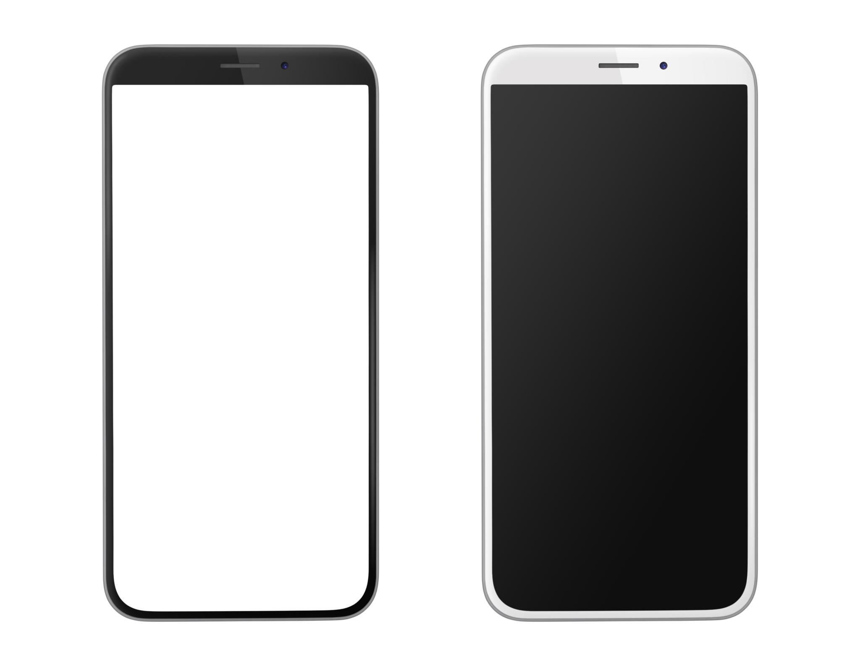
Advancements in Display Quality: Retina, OLED, and AMOLED
Retina Display Technology
Retina technology significantly enhances image clarity by providing high pixel density, making images look sharp and detailed.
OLED Technology
OLED screens offer improved color accuracy and deep blacks, enhancing the visual experience on smartphones and other devices.
AMOLED Technology
AMOLED technology combines the benefits of OLED with active matrix control, resulting in enhanced energy efficiency and faster refresh rates.
Notes:
Significant advancements in display technology, such as Retina, OLED, and AMOLED, have improved image clarity, color accuracy, and energy efficiency, enhancing the overall smartphone experience.

Slide 16
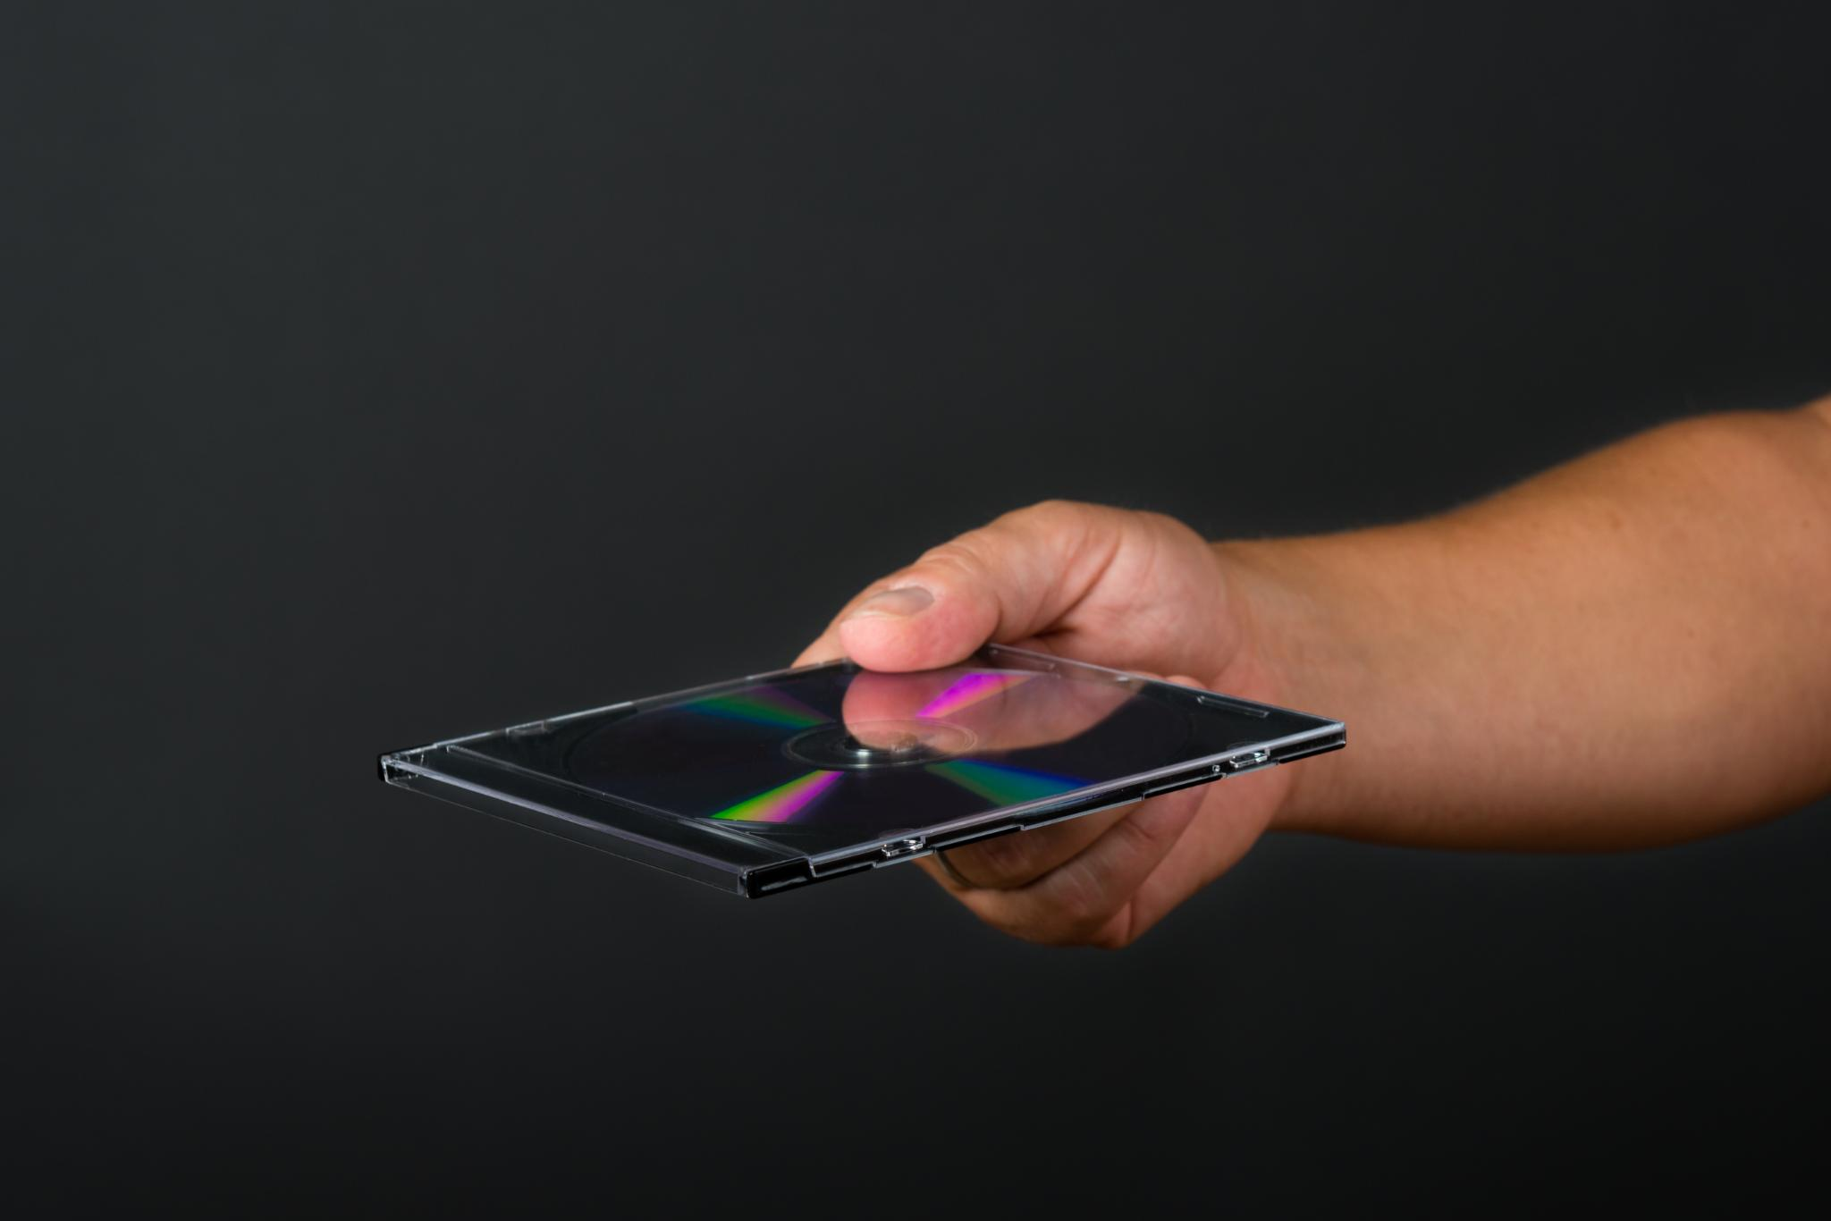
Future Trends in Phone Display Technology
Flexible Screens
Flexible screen technology will enable new design innovations, allowing smartphones to bend and adapt to user needs.
Foldable Screens
Foldable screens will offer expanded screen real estate and multifunctionality, revolutionizing how users interact with their devices.
Design and Functionality
The advancement in display technology will lead to innovative designs, enhancing user experience and device functionality.
Notes:
Future display technologies are expected to focus on flexible and foldable screens, offering new possibilities for design and functionality in smartphones.

Slide 17
Impact on Society and Daily Life
Notes:
Smartphones have profoundly impacted communication, business, and culture, altering how individuals interact and connect with each other and the world around them.

Slide 18

Changes in Communication and Social Interaction
Instant Messaging Revolution
Smartphones have enabled instant messaging, allowing people to communicate in real-time regardless of distance.
Video Calling Impact
Video calls have transformed how we connect, making virtual face-to-face communication more accessible and personal.
Social Media Dynamics
Social media interactions have reshaped personal relationships and social dynamics, fostering connections and community.
Notes:
Smartphones have revolutionized the way we communicate, enabling instant messaging, video calls, and social media interactions, which have transformed personal relationships and social dynamics.

Slide 19
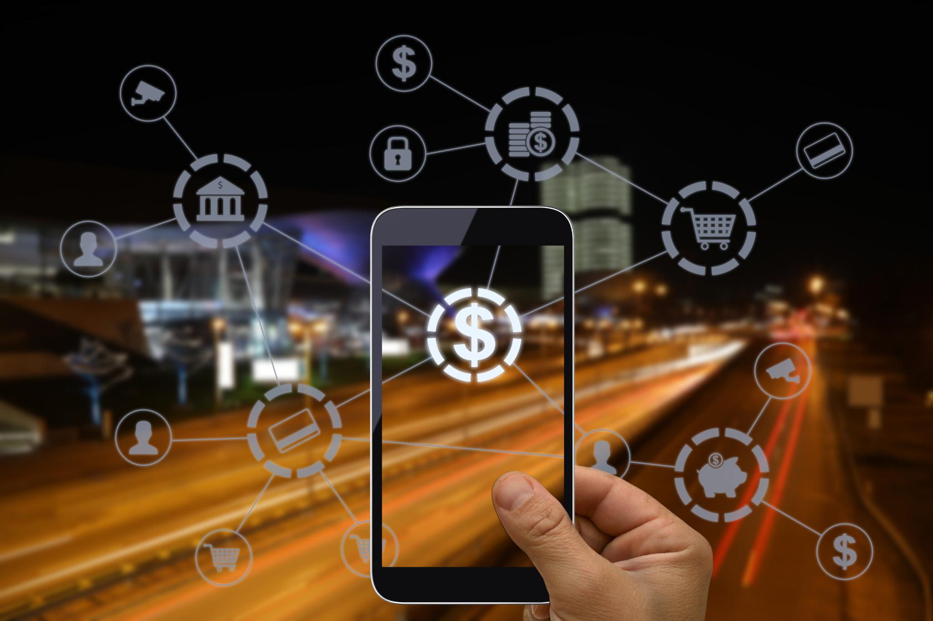
Influence on Business and Industry
Transformation of Mobile Commerce
Smartphones have revolutionized mobile commerce, allowing consumers to shop conveniently from anywhere at any time.
Enhanced Productivity
Productivity has increased due to smartphone applications that streamline tasks and improve efficiency in the workplace.
Customer Engagement
Smartphones have changed the way businesses interact with customers, fostering more personalized and immediate communication.
Notes:
The rise of smartphones has transformed industries by facilitating mobile commerce, enhancing productivity through apps, and changing how businesses engage with customers.

Slide 20
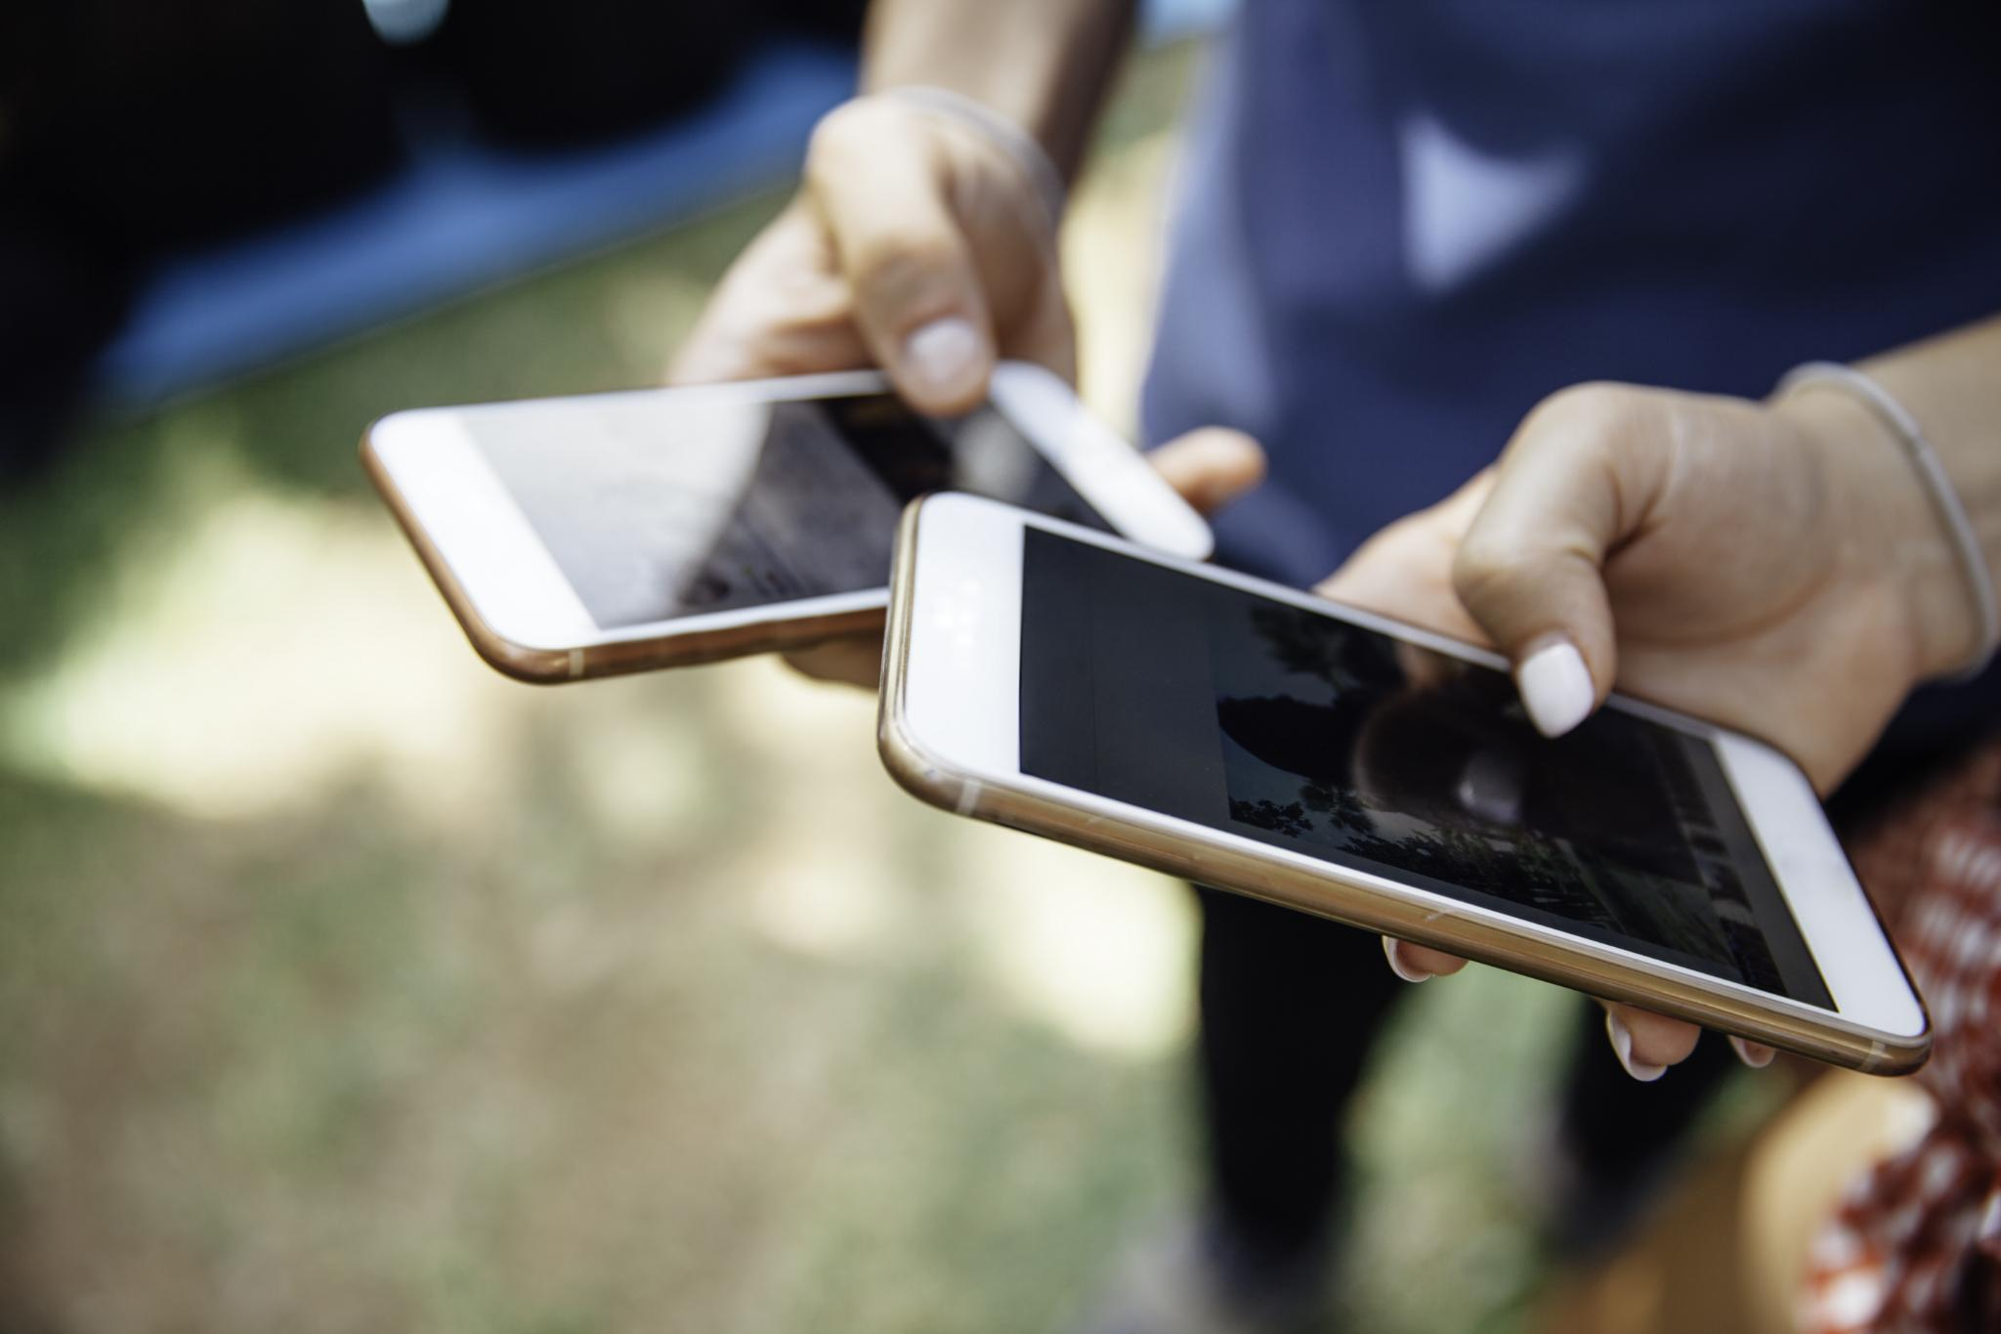
Cultural and Societal Shifts
Entertainment Consumption Changes
Smartphones have transformed how people consume entertainment, shifting from traditional media to on-demand streaming services.
News Dissemination
Smartphones have changed the way news is shared and consumed, enabling instant access to information and diverse viewpoints.
Online Identity Curation
With smartphones, individuals now curate their online identities through social media, impacting personal branding and self-expression.
Notes:
The widespread use of smartphones has led to cultural shifts, including changes in entertainment consumption, news dissemination, and the way individuals curate their identities online.

Slide 21
Future Trends and Innovations
Notes:
As technology continues to advance, the future of smartphones holds exciting possibilities, including faster networks and innovative features powered by artificial intelligence.

Slide 22
Emergence of 5G and Beyond
Faster Data Speeds
5G technology offers significantly faster data speeds compared to previous generations, which will enhance mobile connectivity.
Lower Latency
The lower latency of 5G enables real-time applications, making experiences smoother and more responsive, especially in gaming and communication.
New Applications
5G facilitates new applications in augmented reality, virtual reality, and the Internet of Things, expanding possibilities for developers and users.
Notes:
The rollout of 5G technology promises faster data speeds and lower latency, enabling new applications in augmented reality, virtual reality, and IoT, significantly enhancing smartphone capabilities.

Slide 23
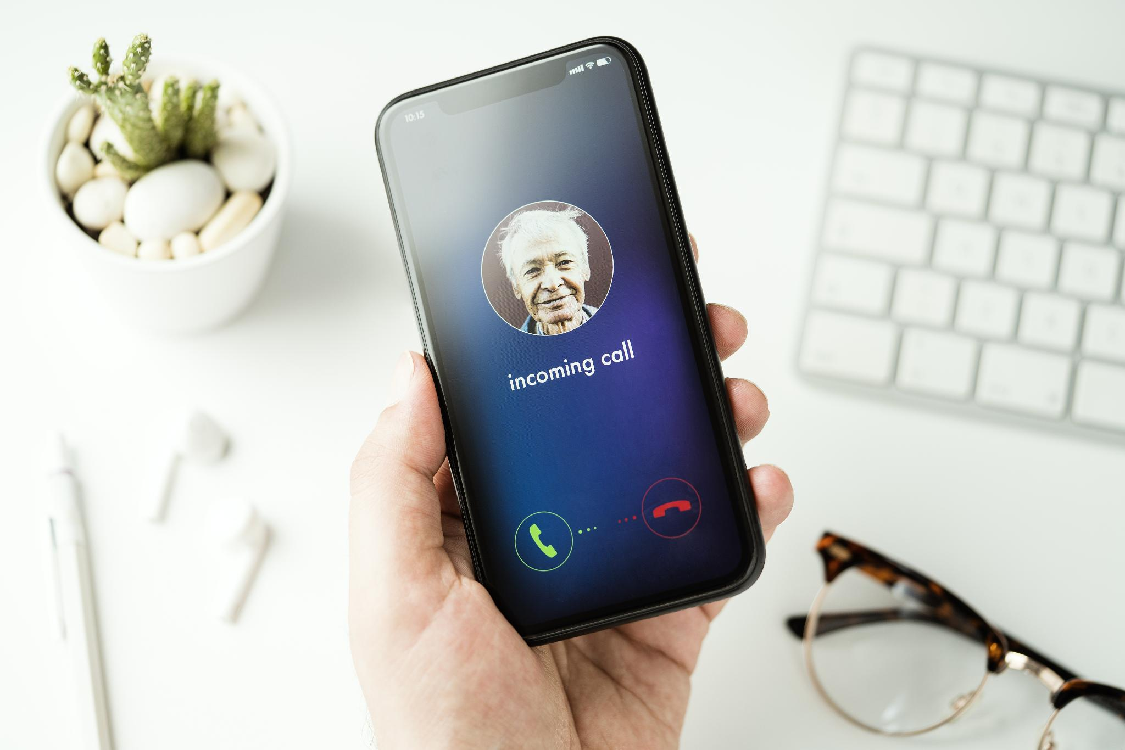
Advancements in AI and Machine Learning
Personalized Recommendations
AI algorithms analyze user behavior to provide tailored recommendations for apps, music, and content, enhancing the user experience.
Advanced Photography
Machine learning improves smartphone photography by optimizing image processing, enhancing low-light performance, and enabling features like portrait mode.
Voice Recognition Technology
AI-driven voice recognition allows users to interact with their smartphones hands-free, making tasks like sending messages and setting reminders easier.
Notes:
AI and machine learning are increasingly integrated into smartphones, enhancing user experiences through personalized recommendations, advanced photography, and voice recognition.

Slide 24

Potential Future Developments and Challenges
Promising Future of Smartphones
The future development of smartphones is likely to focus on enhanced features, connectivity, and user experience.
Privacy Concerns
As smartphones become more integrated into daily life, privacy concerns regarding data collection and usage continue to rise.
Security Threats
The increasing sophistication of cyber threats poses significant security challenges for smartphone users and manufacturers alike.
Sustainable Technology Development
The shift towards sustainable technology in smartphone production and disposal is essential to minimize environmental impact.
Notes:
While the future of smartphones looks promising, it also presents challenges, such as privacy concerns, security threats, and the need for sustainable technology development.

Slide 25
Conclusion
Technological Advancements
Smartphones have evolved significantly due to advancements in technology, enhancing communication and accessibility.
Impact on Communication
Smartphones have transformed the way we communicate, enabling instant connectivity and information sharing across the globe.
Future of Smart Technologies
The ongoing evolution of smartphones suggests a future of even smarter technologies that will further shape our lives.
Notes:
The evolution of smartphones is a testament to technological advancement and innovation. From early mobile devices to today's smart technologies, smartphones continue to shape our lives and the future of communication.

Slide 26

Udemy.com/course/powerpoint-copilot/

